Slide 1
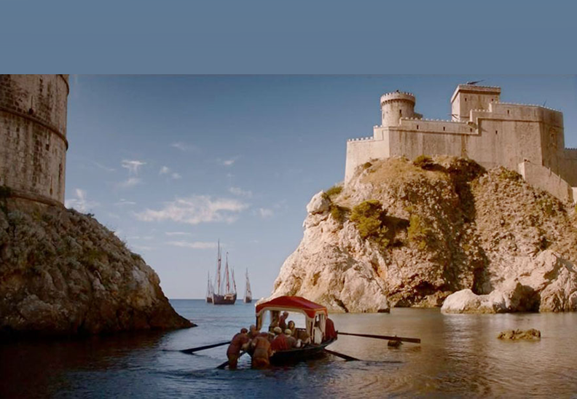
EU Field School 2019
2019 Management Field School to Germany, Slovenia, Austria & Croatia

Slide 2
Why a Field School?
9 course credits (3 upper level electives)
Out-of-the classroom learning
Business and Economics Conference in Dubrovnik, Croatia
Cultural Excursions & Company Tours
May 1 – May 21, 2019 (TBA)

Slide 3
BEE Conference
4th annual Business and Entrepreneurial Economics Conference
Hosted by the Faculty of Business and Economics at University of Zagreb
May 15-18

Slide 4
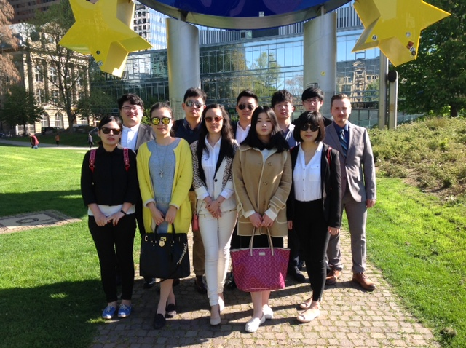
Experiential Learning

Slide 5

Industry Tours

Slide 6
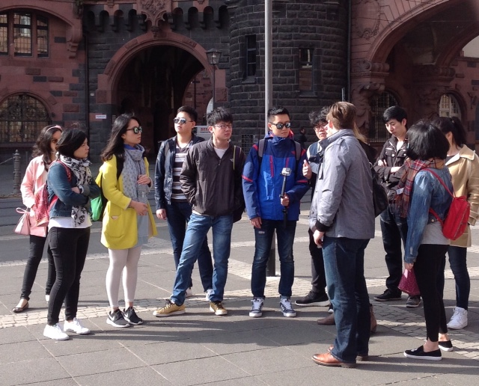
Cultural Visits

Slide 7
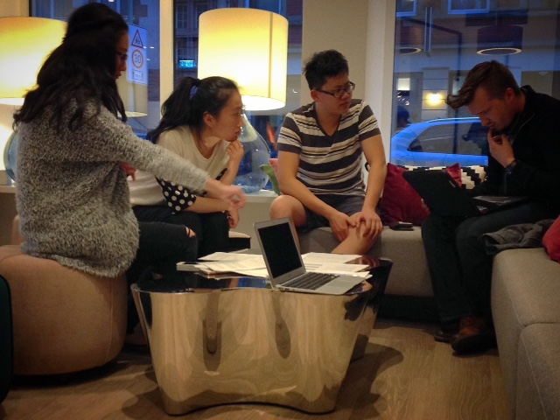
Study Time
9 course credits (3 upper level electives)
  MGMT 397
    European Ecommerce and E-management
    A. Pevec
  MGMT 398
    Canada/EU Trade Relations
    B. Russell
  MGMT 399
    Cross Cultural Business Relationships
    A. Pevec / B. Russell
27 hours pre-departure activities

Slide 8

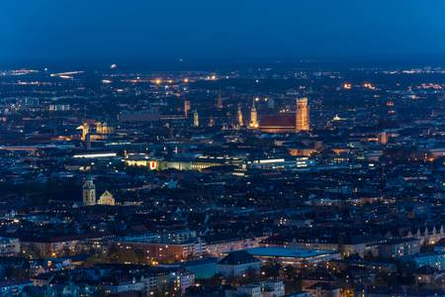
Start in Frankfurt or Munich

Slide 9
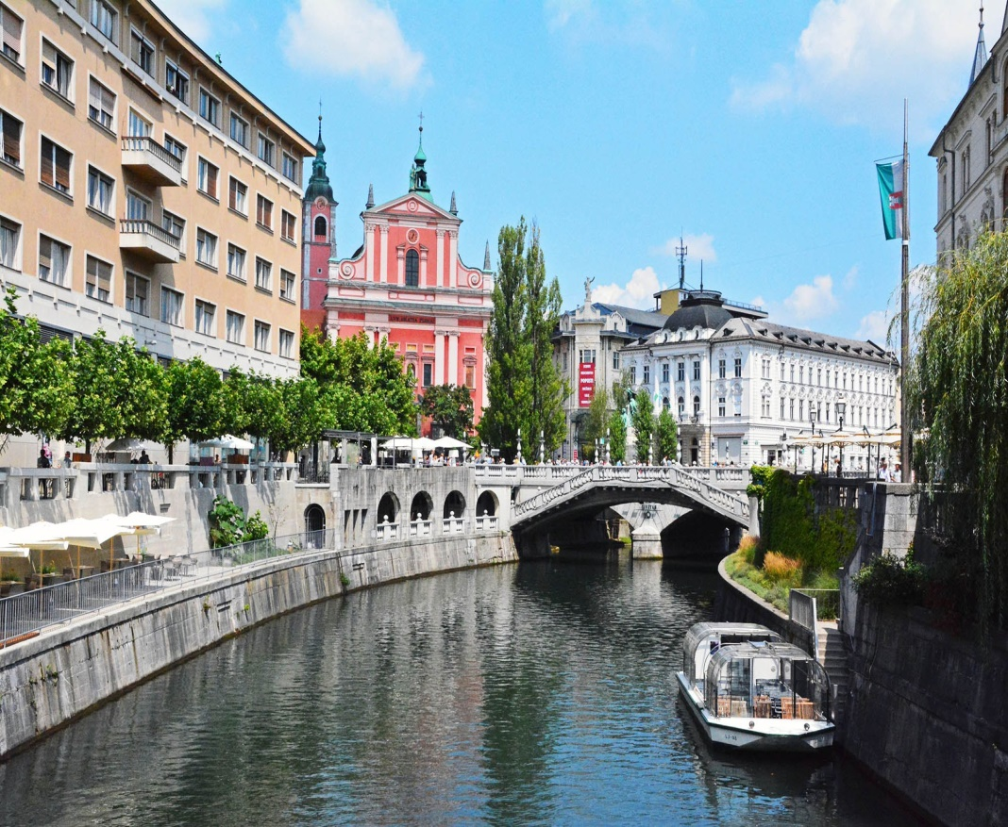
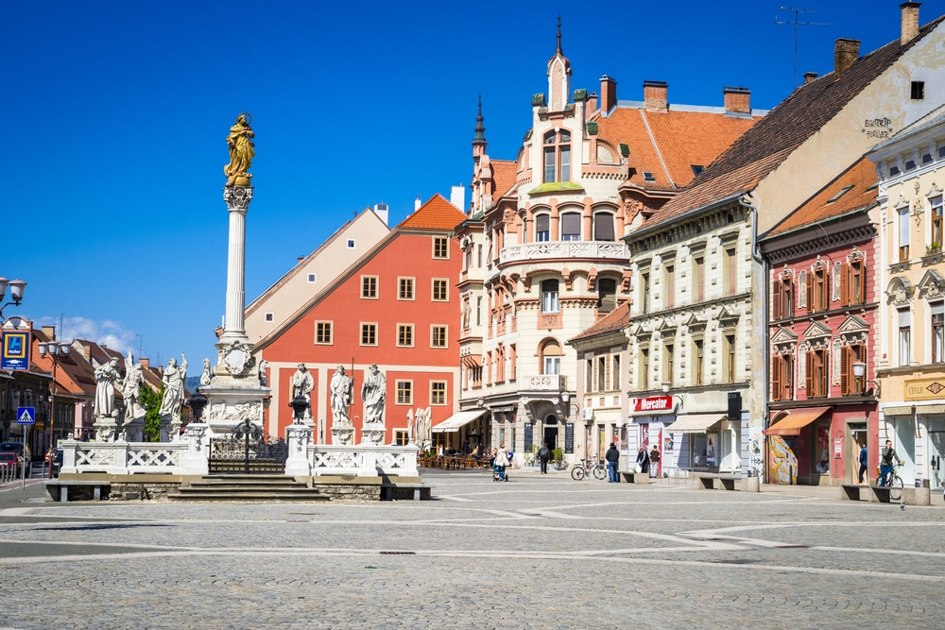
Ljubljana or Maribor, Slovenia

Slide 10

Zagreb, Croatia

Slide 11
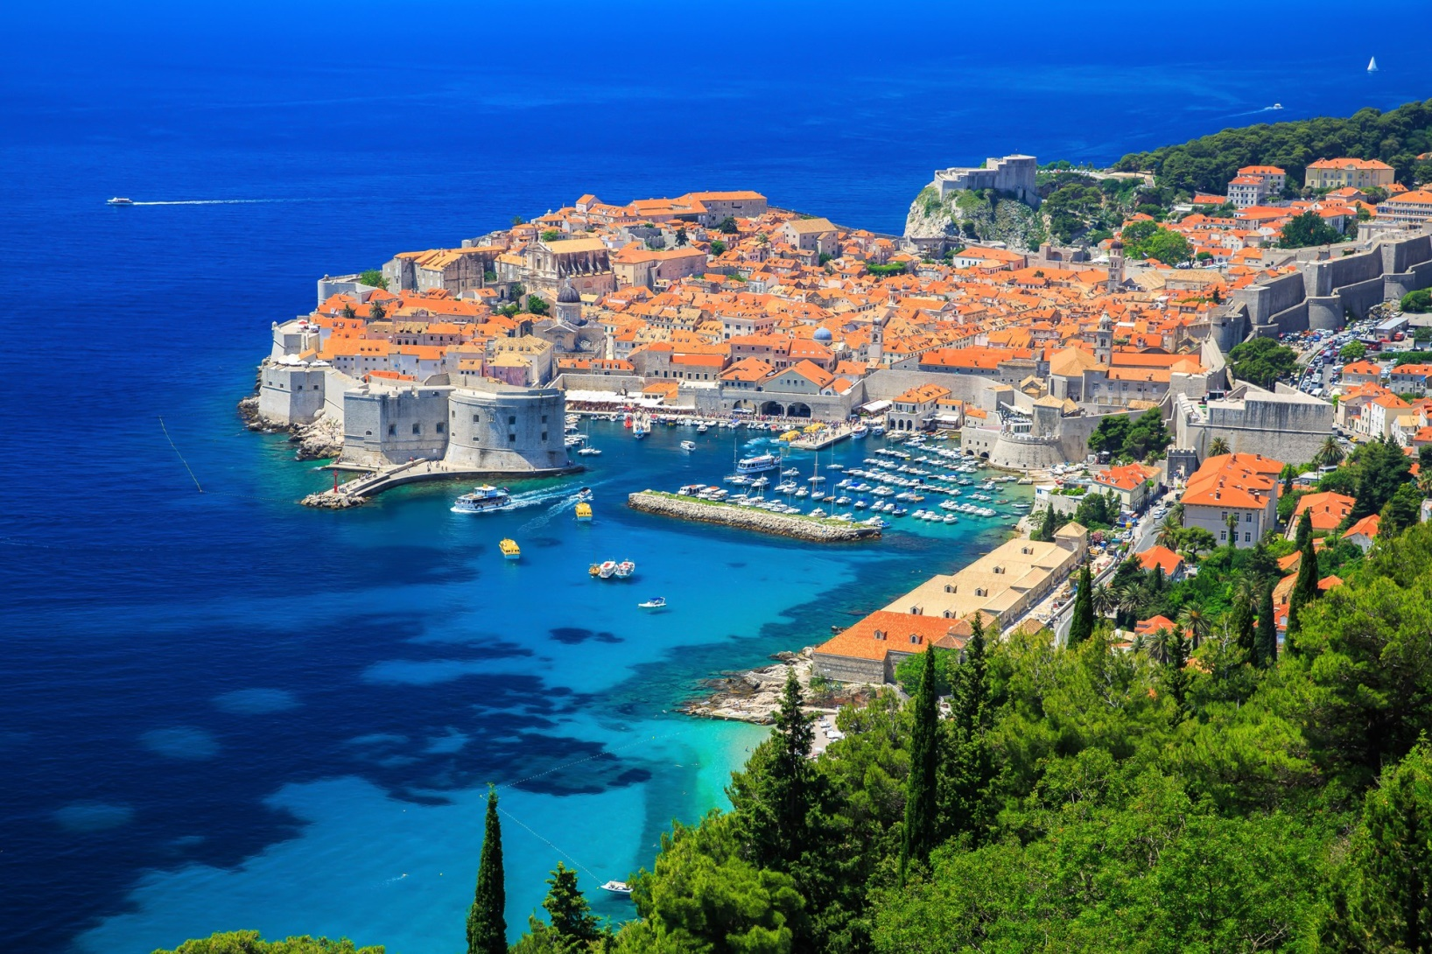
Dubrovnik is a UNESCO World Heritage Site

Slide 12
The Cost
Tuition Fees
Vancouver/Germany Airfare
  Approx. $1,500 (but can be less)
Field School
  $2,500 (covers hotels, ground transportation, entry fees, and group dinners)
Schengen Visa ($88)
Personal Expenditures

Slide 13
How to Apply
On-line application
  https://international.viu.ca/
$500 application fee
Deadline date for applications: Tuesday, Nov.19, 2018
Recruit a friend

Slide 14
Information Sessions B255/R135
Thursday, October 18th and November 1st
11:30am to 12:30pm

